Slide 1


Video Surveillance System
using

Slide 2
Our Team
Mentor
Dr. Hitesh Kumar Sharma
Team Members
Adesh Kumar Gupta
Shankey Gupta
Tushar Singh
Utkarsh Sandeep Singh

Slide 3
Abstract
Security is one of the major concerns in today's world for everyone. People are very much concerned about it and take the best possible measures to ensure it.
In order to overcome this problem and prevent any mishappenings from taking place we are coming up with an enhanced version of this traditional technology that is a “Video Surveillance System” which will detect any unusual activity and based on it will send a prompt via an SMS or mail to the user for which the user can take appropriate action before the damage being done.
In this way the problems that soldiers face on the border can be avoided and if any unknown human being is detected, instant prompt will be sent and the army people can take sudden action against it and avoid any kind of damage from happening.

Slide 4
Introduction
We know surveillance is very important and necessary in today's world. Be it safety of people or safety of precious things surveillance plays a huge role in security purposes. The more important the surveillance of human beings is, the equal it is for other tasks like watching over valuables, monitoring operations, employee safety, loss prevention and public safety.
Video Surveillance System is a great answer to all these issues to maintain an even stronger and reliable level of security. It is a model based on deep learning which is able to detect the right objects in live video almost all of the time.
This system would be capable of capturing images and videos to find out any unusual activities. This system proves to be an enhanced version of the traditional surveillance systems that were used for security purposes.

Slide 5
Problem Statement
As we all know, for the security purposes, CCTV cameras are installed everywhere but the main problem is that it requires 24X7 human monitoring that is not feasible and also if any happening occurs then it doesn’t send us any alert signals. We can only check manually the previously recorded data. That results in huge loss of life, money and property.

Slide 6
Literature Review
[1] The process of analyzing video sequence is termed as Video Surveillance. Video Surveillance activities can be categorized into 3 types manual, semi-autonomous and fully-autonomous. In fully-autonomous video is taken only is the scene where surveillance is need to be performed.
[2] Foundation subtraction techniques are generally abused for moving item recognition in recordings in numerous applications, for example, traffic observing, human movement catch, and video surveillance.
[3] A Bayes choice principle for the arrangement of foundation and the closer view from chosen include vectors is planned. Under this standard, various kinds of foundation items will be arranged from frontal area protests by picking a legitimate component vector.
[4] Surveillance is a vital piece of security and is utilized everywhere throughout the world to guarantee the wellbeing of resources just as individuals. Despite the fact that surveillance is dubious in certain circumstances.

Slide 7
Objectives
To load our model with the different objects.
To identify the objects from the live video streaming.
To send the alert signal in the form of emails, messages, light or sound.

Slide 8
Methodology
Theory:
This project is about automating the surveillance system which will send alerts in case of any unusual activity.
Object Training and Object Identification
For the implementation of this technique, we will use some python modules:
OpenCV: To use computer camera as video capturing device and for image processing.
DarkFlow: To use TensorFlow TFNet module for Object Detection.
Alert through Mail
We are using SMTP protocol for alerting via Mail whenever it will receive any unwanted activity on the camera it will send an alert signal to the respective authorities.

Slide 9
Approach
Object Training and Object Identification
Importing specified modules
Define options to build the model. We are using yolo.cfg model.
Capture live video through webcam
Instantiate TFNet class with options.
Read frames from video until webcam is on.
Pass these frames into TFNet predict function which will return results containing object label, top left & bottom right coordinates and confidence for each object.
For each object:
Extract top left & bottom right coordinates
Store the label
Draw rectangle box around that object and specify label
Show these frames until webcam is on.
In case of border surveillance, if label is human an alert will be generated.
Similarly, based on different parameters (predefined) we can generate alerts.

Slide 10
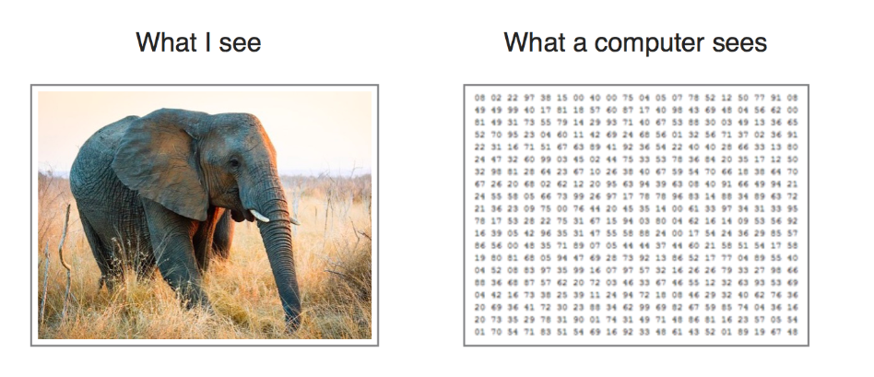

Slide 11
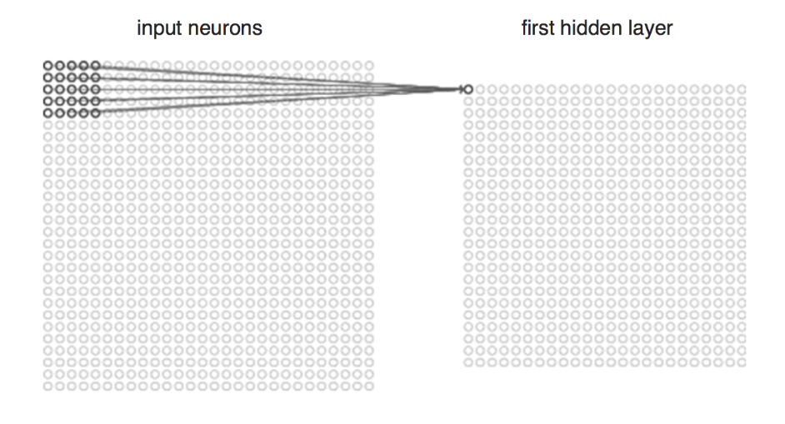

Slide 12
Approach (Continued…..)
Alert through Mail
Import required libraries for smtp protocol
Create server connection with Gmail by respective port no.
Provide login details of sender
Provide details of sender and receiver along with the message to be passed
Terminate the connection

Slide 13
Output

Slide 14
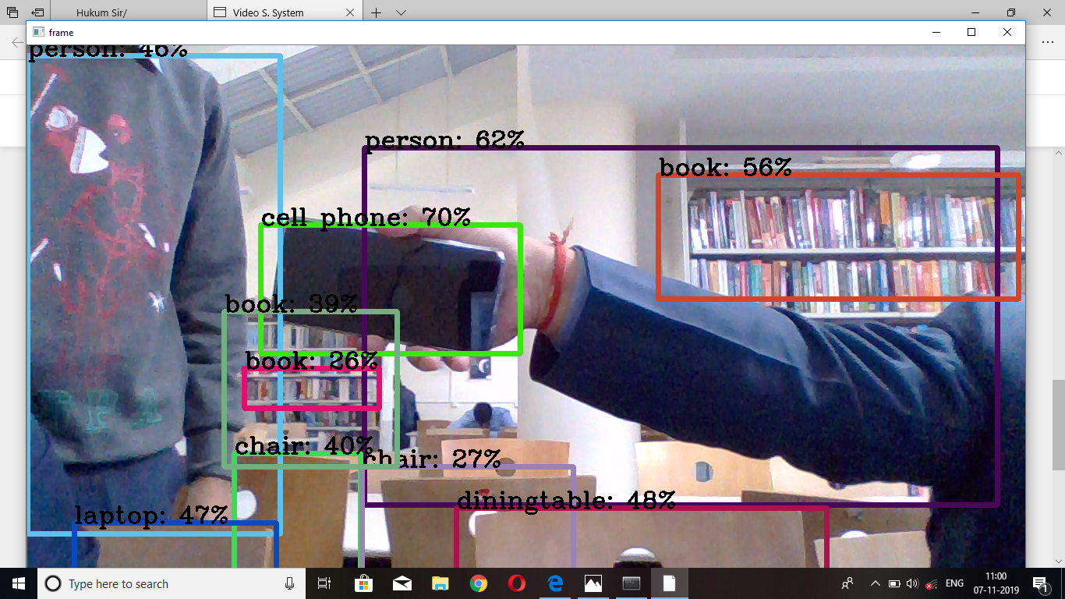
Object Detection and Identification

Slide 15
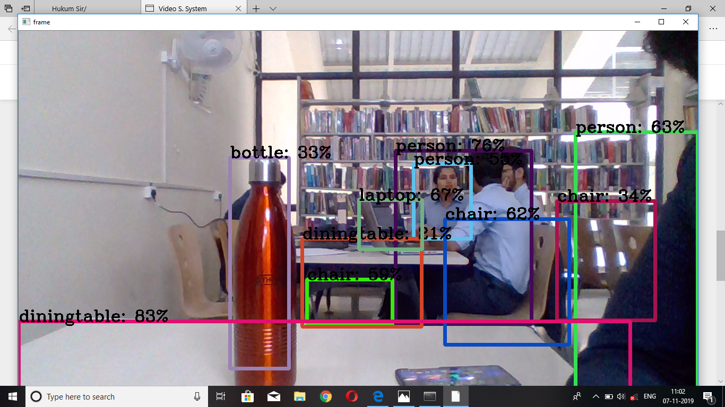

Slide 16
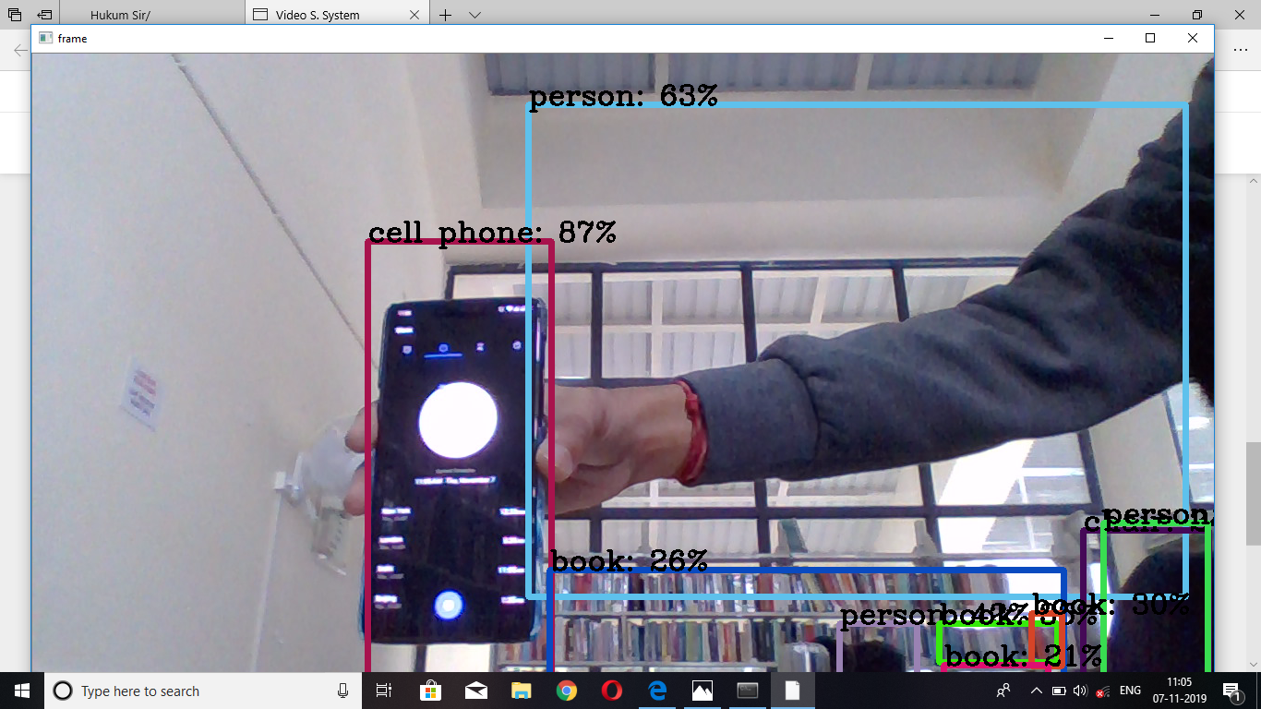

Slide 17
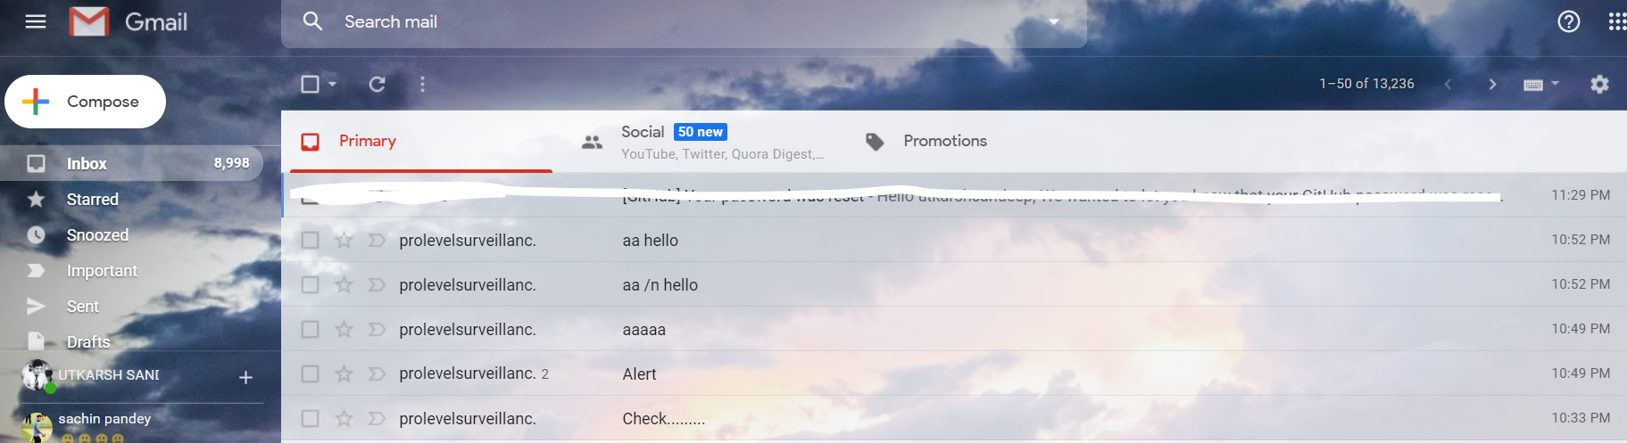
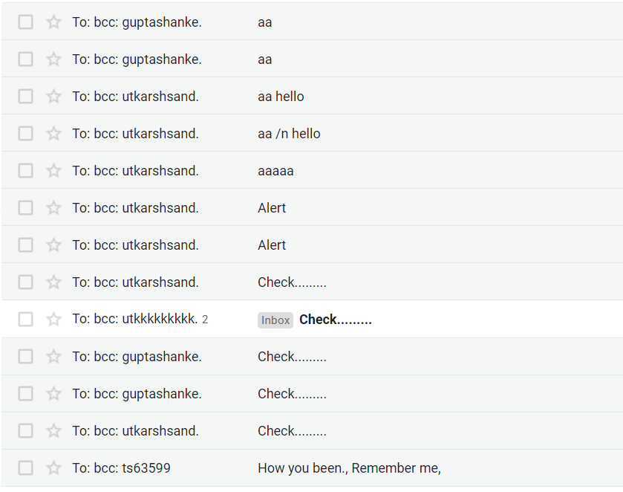
Alert Mail

Slide 18
System Requirements: (Software/Hardware)
Hardware:
RAM- 8 GB
Processors- Intel Core i5/i7
Nvidia GTX 1660
HDD- 2GB
Software:
Operating System- Windows 10/8.1/8/7/XP | Ubuntu| RedHat
Programming Language- Python

Slide 19
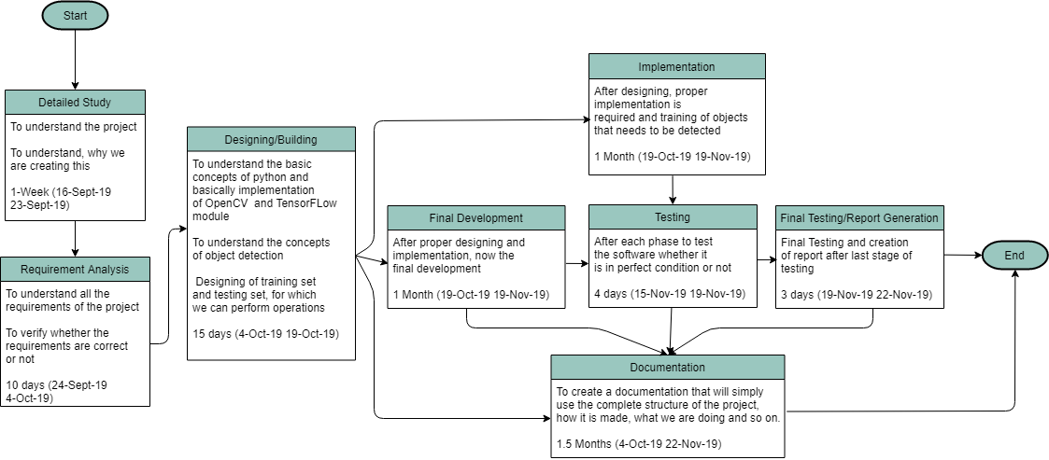
PERT Chart

Slide 20
References
A Survey on Moving Object Detection and Tracking in Video Surveillance System http://citeseerx.ist.psu.edu/viewdoc/download?doi=10.1.1.645.7492&rep=rep1&type=pdf
Detecting moving objects, ghosts, and shadows in video streams
https://ieeexplore.ieee.org/abstract/document/1233909
Foreground object detection from videos containing complex background
https://dl.acm.org/citation.cfm?id=957017
Simple Surveillance System with the TensorFlow Object Detection API
https://towardsdatascience.com/simple-surveillance-system-with-the-tensorflow-object-detection-api-125e04d36446

Slide 21
Thank You
Have a nice day!!!

